Slide 1

Modelling the Pandemic
Sociodemographic predictors of COVID-19 impact in Chicago neighborhoods
by
Bored Grads Yacht Club
Christopher Owen
cowen20@uic.edu
https://github.com/antennarius
Kazi Shahrukh Omar
komar3@uic.edu
https://github.com/komar41
Abdul Rafey Siddiqui
asiddi73@uic.edu
https://github.com/rafeyyyyy
Nguyen Hoa Pham
npham30@uic.edu
https://github.com/nhpham27
Gautam Kushwah
gkushw2@uic.edu
https://github.com/gautam-kushwah
Group repository: https://github.com/uic-cs418/cs418-spring22-bored-grad-yacht-club

Slide 2
Our motivation for this project
The COVID-19 pandemic has been a historic, life-changing and terribly unfortunate event in our lives.
As data science students, we were very interested in the widely available data for this pandemic.
The main question we landed on through our initial research was:
Is there a way to link COVID-19 impact to socio-demographic data?
With our project, we hope to answer this question!

Slide 3
Some definitions
How do we define sociodemographic data?
Physical factors like age, gender, ethnicity etc.
Social factors like income, level of education, time spent on public transit etc.
How do we define COVID-19 impact?
Number of COVID-19 cases.
Number of COVID-19 deaths.

Slide 4
Where we started off
We focused on COVID-19 data for the city of Chicago.
We found an existing COVID-19 risk metric called the CCVI index:
This model ranks Chicago neighborhoods on sociodemographic data.
Assigns a COVID risk score for each neighborhood based on the rankings.
A potential flaw with this model is that the score relies on neighborhood rankings.
For example, 2 neighborhoods could be one rank apart in terms of income, but have vastly different average income compared to the next ranked neighborhood.
Our model aims to improve upon this index.

Slide 5
Our COVID-19 model
With our model, we aim to achieve:
Quantifiability of COVID-19 impact
The model should be able to predict the number of COVID-19 cases/deaths based on socio-demographic data.
Accuracy and uniformity
The predictions should be based on exact variable values, not rankings.
Why is this important?
Distributing healthcare resources more equitably.
Targeting vaccinations.
Designing policy to help areas most in need.

Slide 6
Gathering data
Gathered COVID-19 data and socio-demographic data for Chicago.
COVID-19 data was collected from the Chicago Data portal:
Included COVID-19 case/death data along with the victim’s ZIP code.
Socio-demographic data was collected from the CensusReporter website:
Scraped ZIP code-based data to match granularity of COVID-19 data.

Slide 7
Cleaning data
Cleaned COVID-19 data for Chicago:
Removed instances of death where manner of death was accident or suicide.
Removed ZIP codes outside of Chicago.
Removed unneeded columns.
Aggregated cases and deaths per ZIP code.
Cleaned socio-demographic data for Chicago:
Removed unneeded columns
Merged the datasets:
Each line represents a ZIP code with its COVID-19 and socio-demographic data.
Normalized Covid deaths and cases by each ZIP code's population:
Cases/deaths per 1000.

Slide 8
EDA and Visualizations
For our EDA, we looked at the correlations between different socio-demographic factors and COVID-19 data.
We created some visualizations to better understand these relationships.

Slide 9
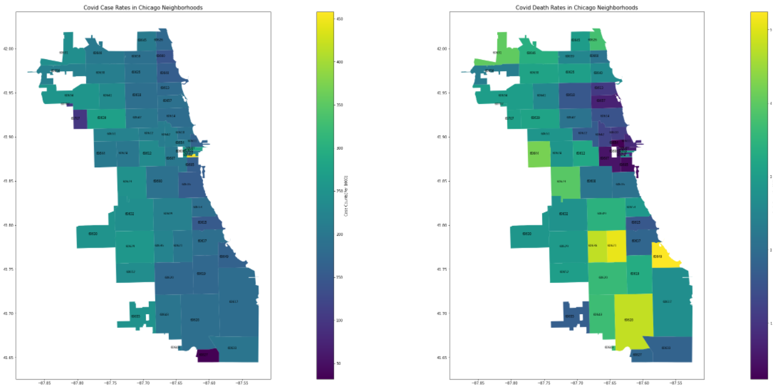
EDA and Visualizations

Slide 10
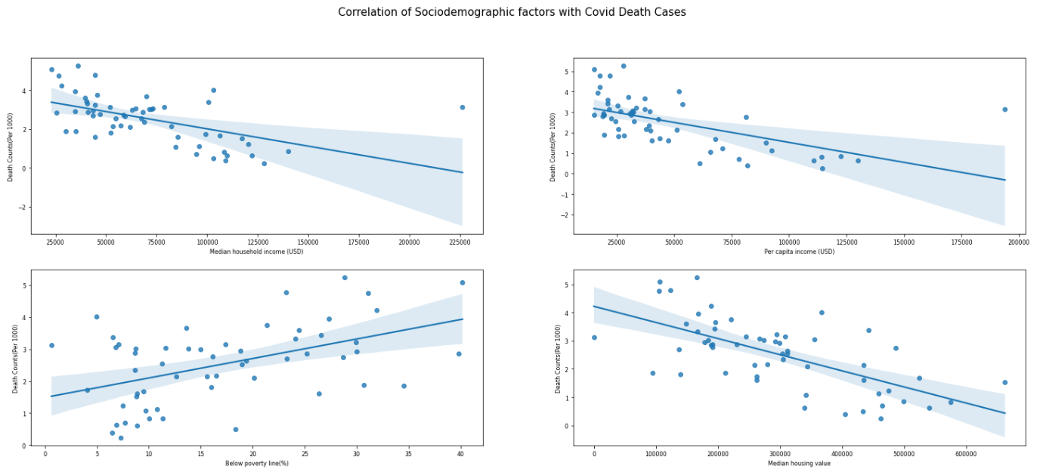
EDA and Visualizations

Slide 11
Selecting socio-demographic factors
We wanted to see which features were most important to predicting COVID-19 cases/deaths.
The importance (on a 0-1 scale) indicates a correlation between that socio-demographic factor and COVID-19 (1 being the highest correlation).
We selected features with an importance of above 0.5.

Slide 12
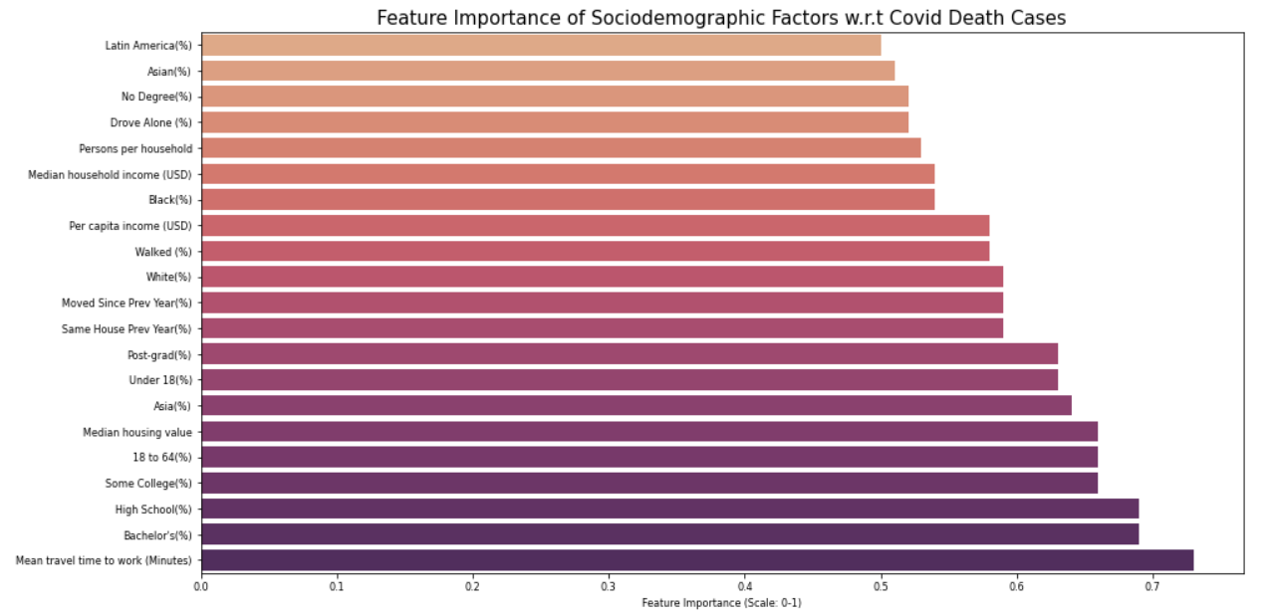
Selecting socio-demographic factors

Slide 13
Random forest regression model
Baseline model: deaths/1000 equal to median for all ZIP codes.
Average absolute baseline error = 1.03 deaths per 1000.
Data split into 70% training data, 30% testing data.
Socio-demographic factors with correlation coefficients >0.5 were selected.
Optimizing hyperparameters for RFR:
Randomized search strategy across a grid of possible hyperparameter values.
Repeated K-fold cross validation, 5 repeats of 2 splits for each randomly-selected combination.
Average absolute model error = 0.62 deaths per 1000.

Slide 14
Principal Component Analysis
PCA to visualize the distribution of COVID-19-related death rates across factors.
Only training data from RFR model was used for this analysis.
We found a pattern between socio-demographic factors and COVID-19 deaths.
Substantial amount of noise present in the data.

Slide 15
XGBoost Model
70% training data, 30% testing data
Socio-demographic factors with correlation coefficients >0.5 were selected.
Average absolute baseline error = 0.96 deaths per 1000.
Average absolute model error = 0.63 deaths per 1000.

Slide 16
Key takeaways
21 of the 48 socio-demographic factors from census data showed strong correlation to COVID-19 impact.
Some of the most important indicators for COVID-19 impact were:
Travel time to work
Education level
Age
Principal Component Analysis showed pattern between COVID-19 deaths and socio-demographic factors.
Our RFR model predicted COVID-19 death rate with an error rate of 0.62 deaths/1000.
Our XGBoost model predicted COVID-19 death rate with an model error rate of 0.63 deaths/1000.

Slide 17
Improving the model
Our current model only incorporates 60 ZIP codes.
We are currently in the process of incorporating more ZIP code based data into our model.
This new data is from different cities and states in America.
More data points will allow us to train a more accurate model and reduce our model error rate.

